Slide 1
Group 1
Data Mining and Business Intelligence
Ekaterina Burkhanova, Neehar Namjoshi, Pooja Shah

Slide 2
Table of Contents
Introduction
Exploration of Data
Model Comparison
Business Recommendation

Slide 3
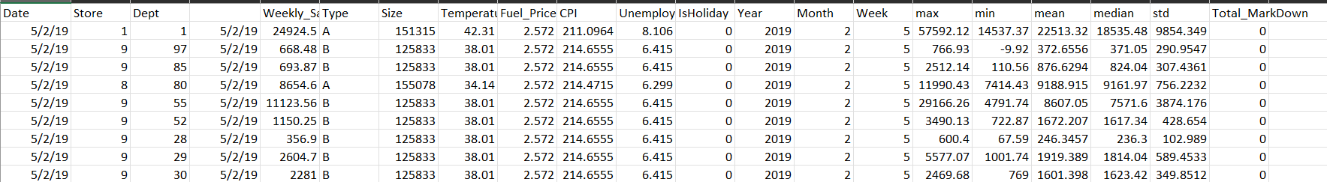
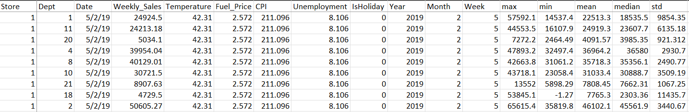
Introduction of Dataset
Change the format of the “Date” from dd/mm/yyyy to mm/dd/yyyy.
Removed 4 columns.
We will use only the “1” segment in the “Store” column.
Use dependent variable – “mean”. Independent variables will be “Temperature”, “Fuel_Price”, “CPI”, “Unemployment”, “IsHoliday”.
The total variables are 17 and 9000+ rows.

Slide 4
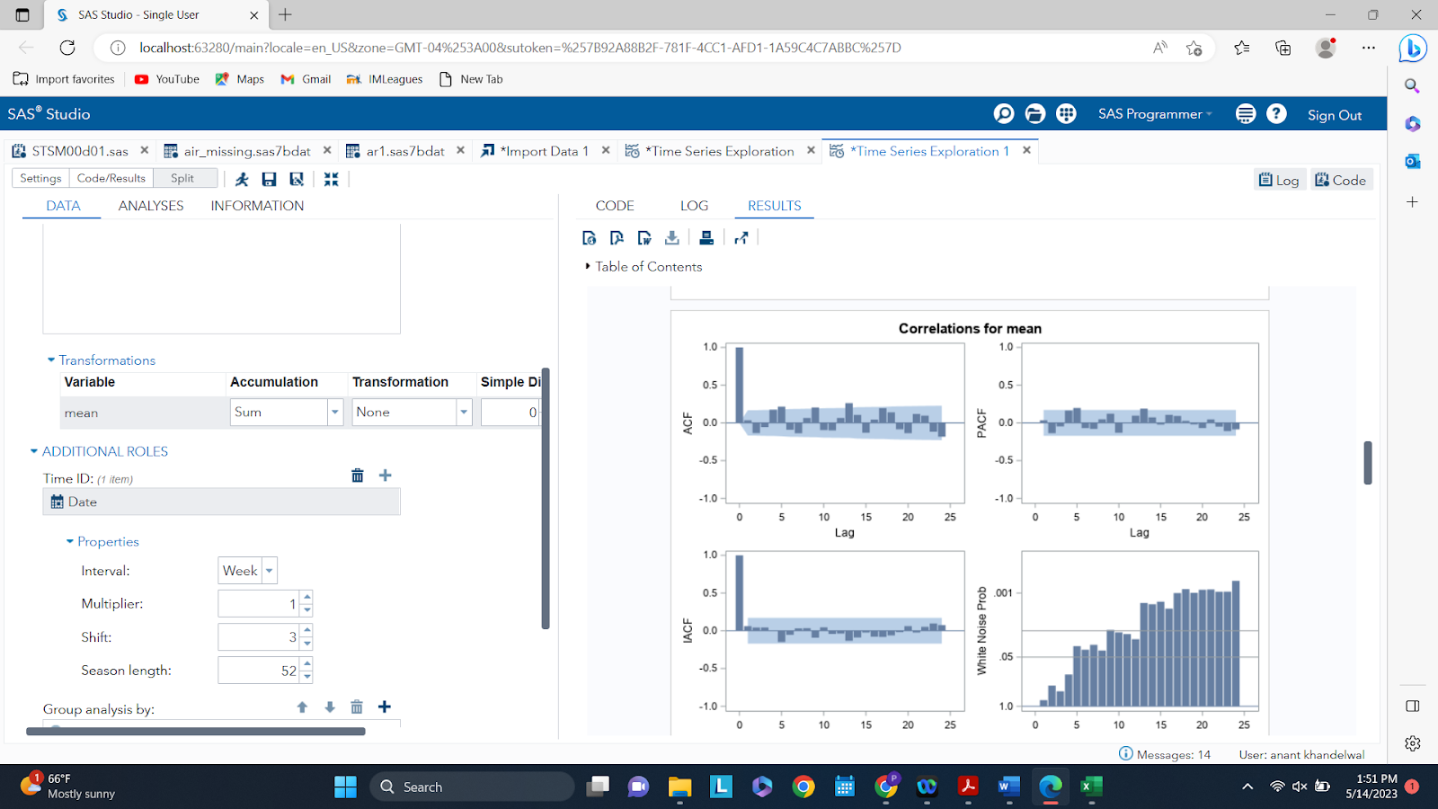
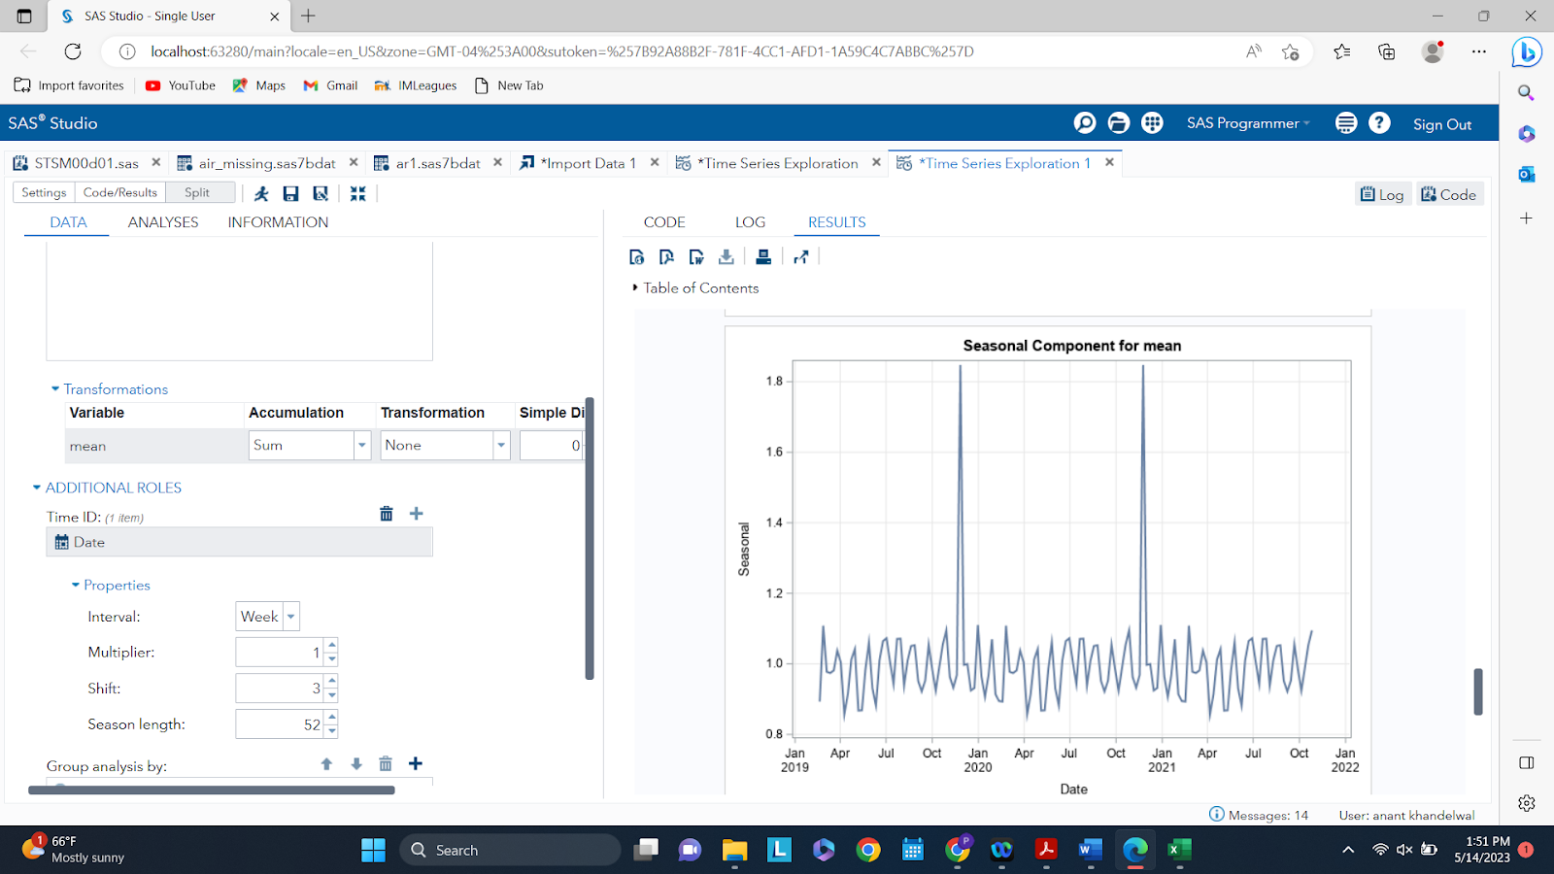
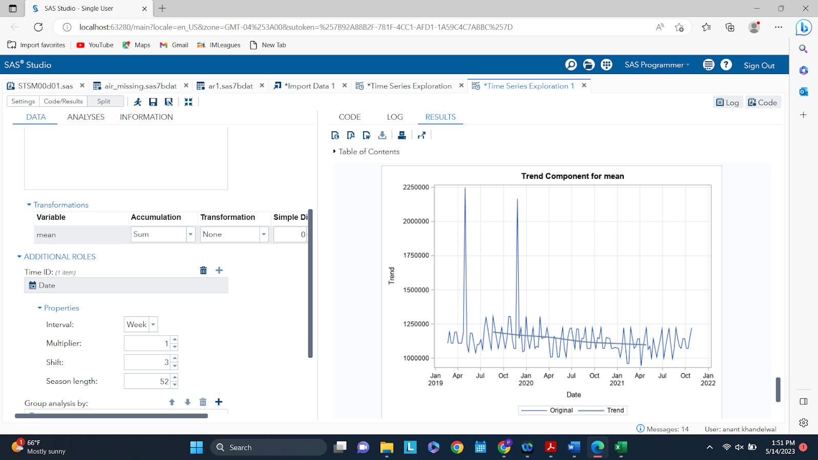
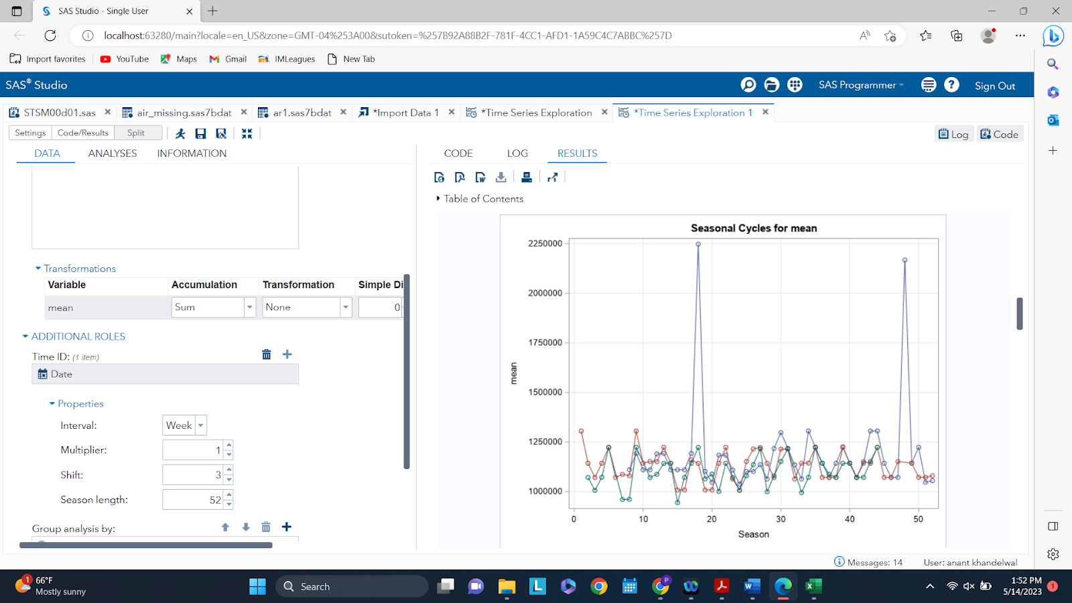
Exploration of Data - Dependent Variable
Dependent variable – “mean”. Accumulation “Sum”. Additional Role – “Date” – “Week”

Slide 5
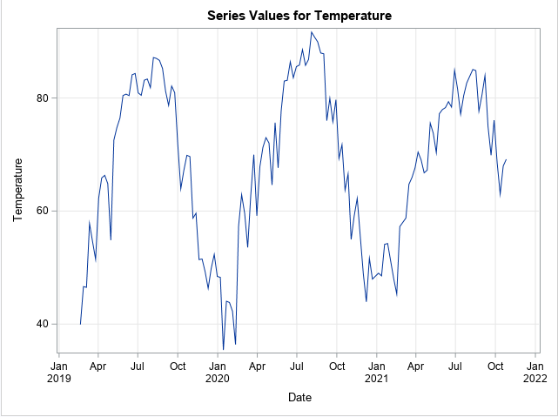
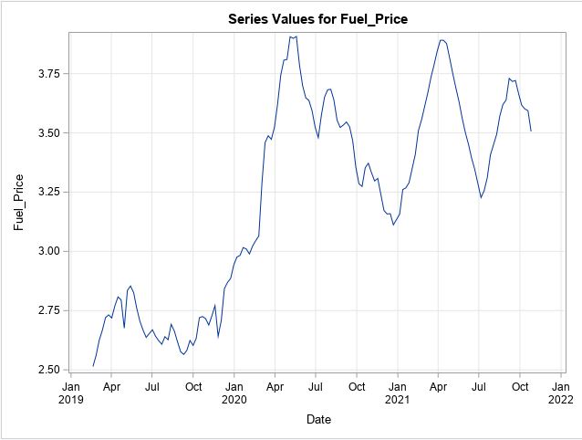
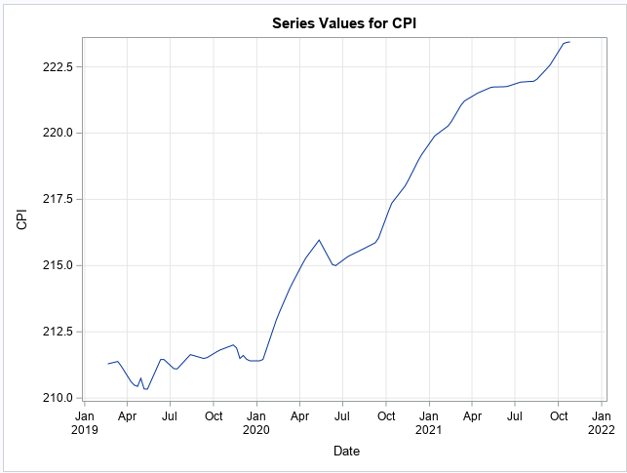
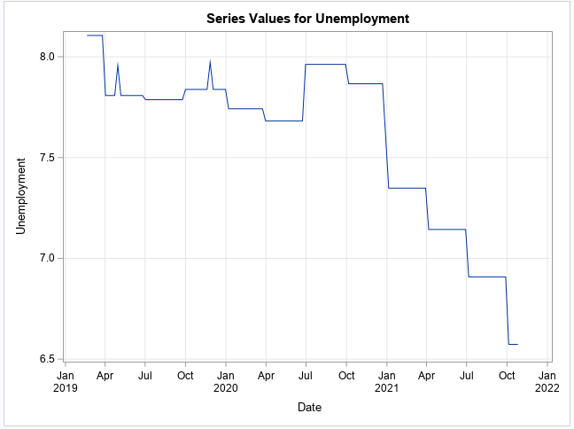
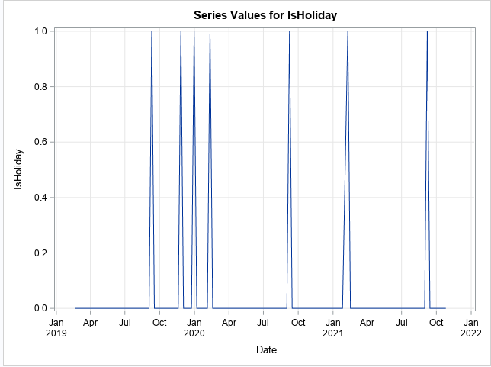
Exploration of Data - Independent Variables
Temperature
Fuel_Price
CPI
Unemployment
IsHoliday
Notes:
What variables appear important?
What trends or patterns have you identified that are relevant to the business problem?
What interesting variable relationships have you discovered? Include visualizations to support your observations.

Slide 6
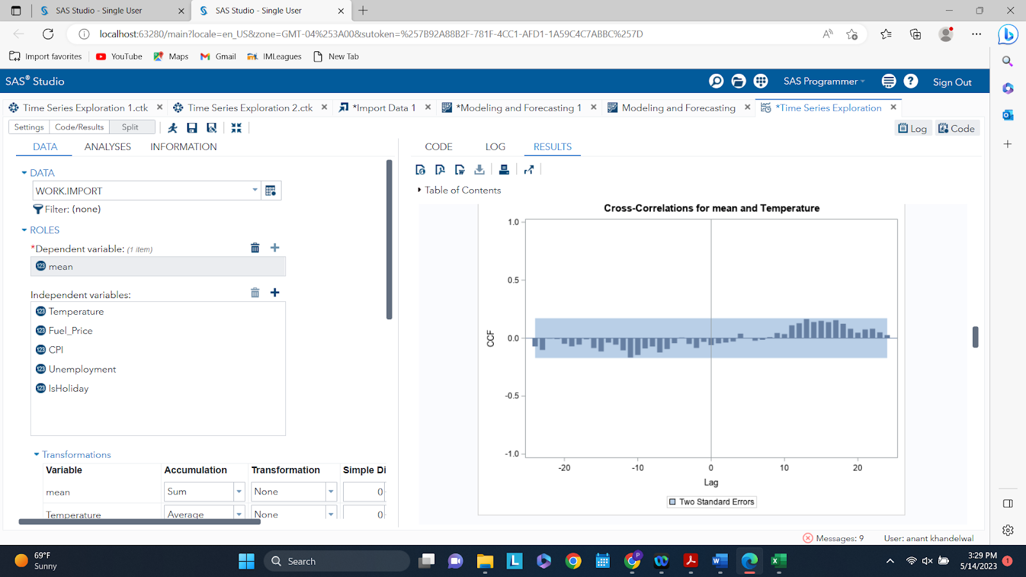
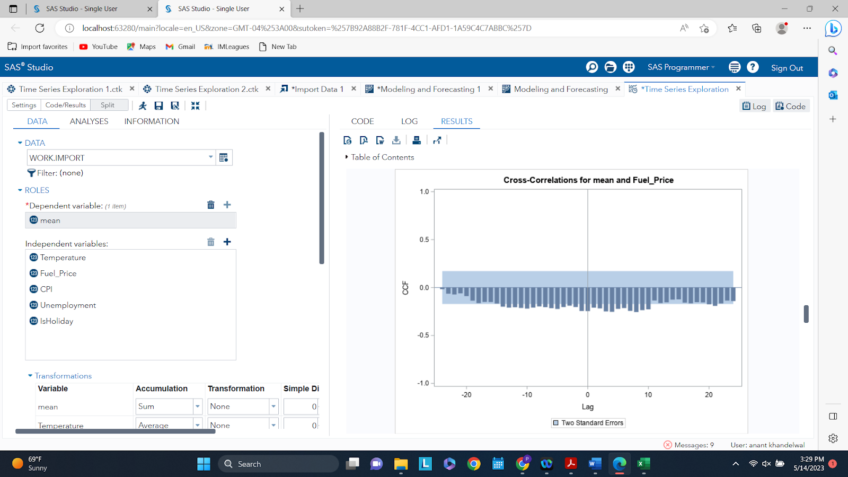
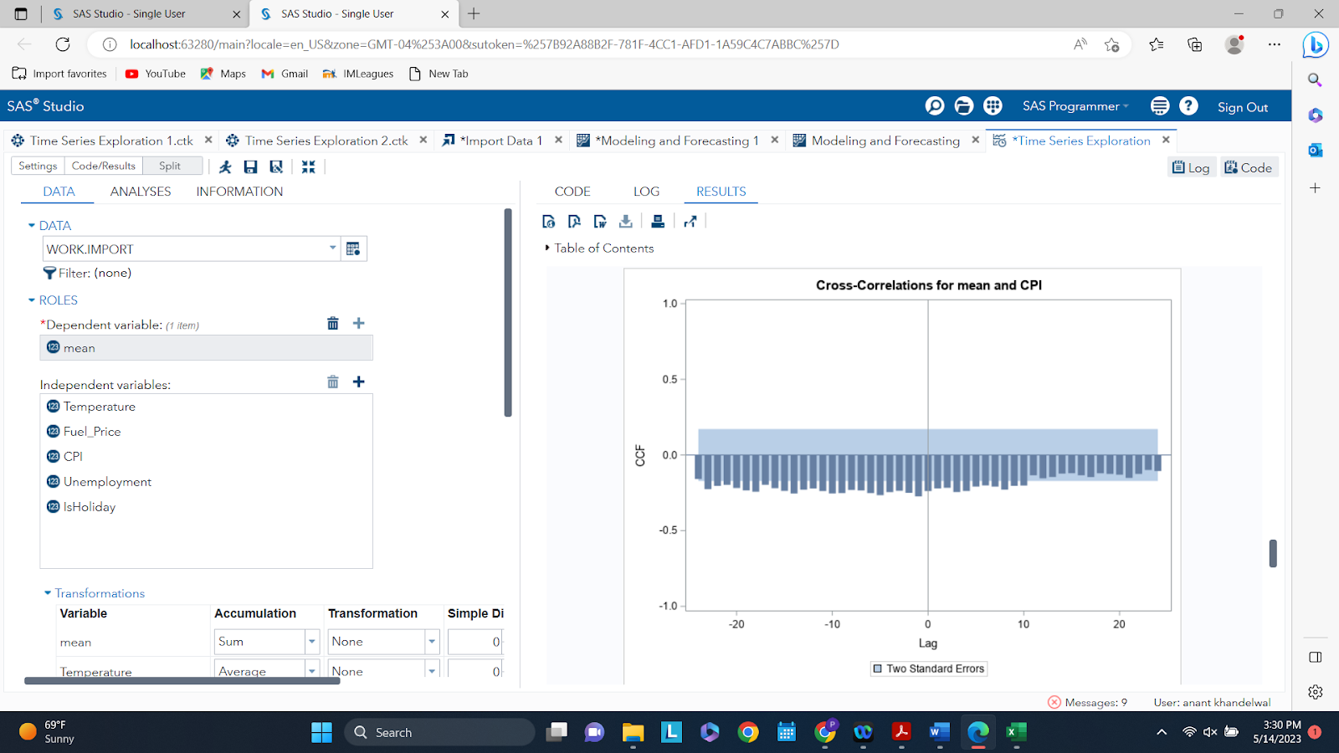
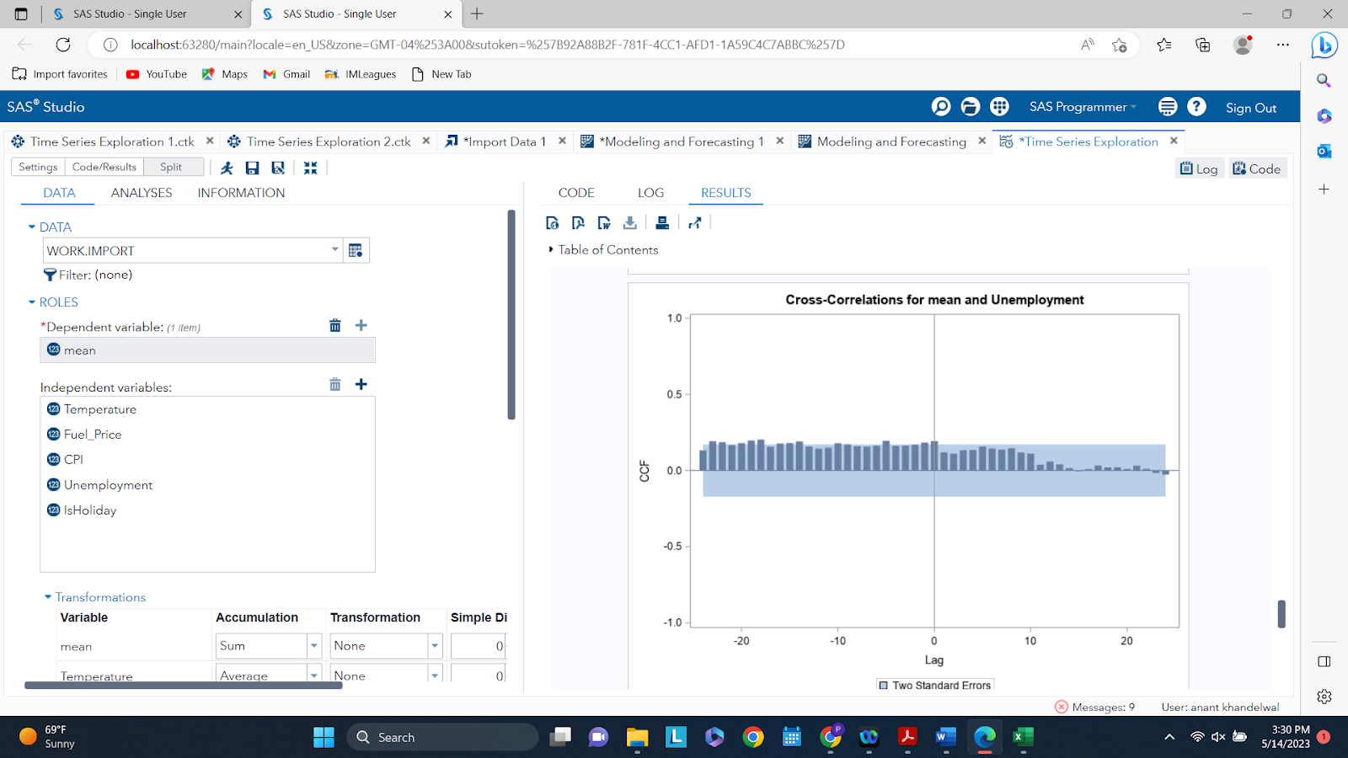
Exploring Variables (Cross-Correlation)
Temperature
Fuel_Price
CPI
Unemployment
Notes:
What variables appear important?
What trends or patterns have you identified that are relevant to the business problem?
What interesting variable relationships have you discovered? Include visualizations to support your observations.

Slide 7
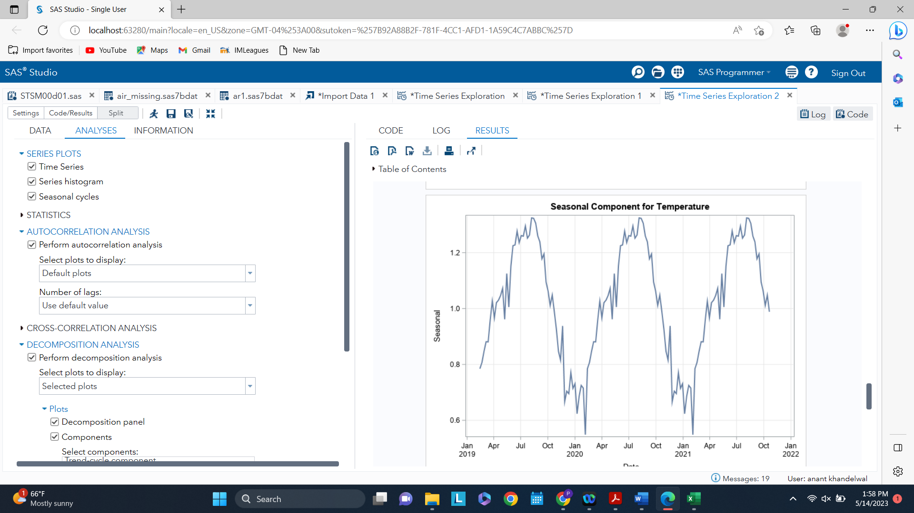
Exploring Variables (Time Series?)
Example Seasonal Component of Temperature
Temperature, Fuel Price, CPI, and Unemployment were found to be time series
IsHoliday is a categorical variable that is also retained for modeling purposes
Decision
Pre-Whitening Analysis of 4 independent variables
Notes:
What variables appear important?
What trends or patterns have you identified that are relevant to the business problem?
What interesting variable relationships have you discovered? Include visualizations to support your observations.

Slide 8
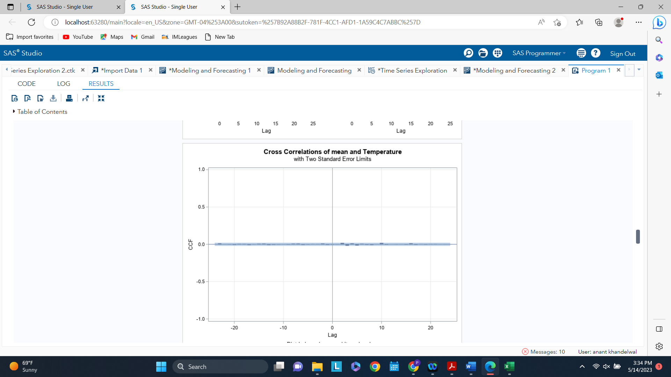
Pre-Whitening
Example Pre-Whitening Cross Correlation between Dependent Variable (Weekly Sales) and Temperature
No Cross Correlation was found for any of the 4 variables
Decision
Will keep or drop independent variables based on the fit metrics
Notes:
What variables appear important?
What trends or patterns have you identified that are relevant to the business problem?
What interesting variable relationships have you discovered? Include visualizations to support your observations.

Slide 9
Temperature + CPI + Unemployment + Fuel price
Variable selection for models
Stochastic
variables:
Deterministic
variables:
Is Holiday

Slide 10
Comparing the best set of models to predict our dependent variable: Mean Weekly sales
Modeling and Forecasting
ARIMA -> p = 0; q = 2
1.
ARIMAX -> p = 0; q = 0
2.
Pre-whitened variables
+
Exogenous variables
ARIMAX -> p = 1; q = 0
3.
ARIMAX -> p = 0; q = 1
4.
ARIMAX -> p = 1; q = 1
5.
ARIMAX -> p = 2; q = 0
6.
ARIMAX -> p = 0; q = 2
7.
ARIMAX -> p = 2; q = 2
8.

Slide 11
Selecting the lowest MAPE model along with checking the goodness of fit
Deep Diving into the accuracy and fit measures
Models | SSE | n | p | MSE | MAPE | AIC | SBC
ARIMAX(2,0) | 3790941127794 | 9280 | 8 | 408859052 | 2.22% | 210334.4 | 210391.5
ARIMAX(1,0) | 4244368791590 | 9280 | 7 | 457712584 | 4.02% | 211380.5 | 211430.4
ARIMAX(2,2) | 2883675746369 | 9280 | 10 | 311076132 | 4.14% | 207808.5 | 207879.8
ARIMAX(0,2) | 2861874675199 | 9280 | 8 | 308657752 | 4.30% | 207734.3 | 207791.4
ARIMAX(0,0) | 2861335610903 | 9280 | 6 | 308533061 | 4.58% | 207740.8 | 207783.6
ARIMAX(1,1) | 2862478387514 | 9280 | 8 | 308722863 | 4.69% | 207736.2 | 207793.3
ARIMA(0,2) | 2862062283406 | 9280 | 3 | 308511618 | 5.00% | 207724.9 | 207746.3
ARIMAX(0,1) | 2862621818212 | 9280 | 7 | 308705038 | 5.23% | 207734.7 | 207784.7

Slide 12
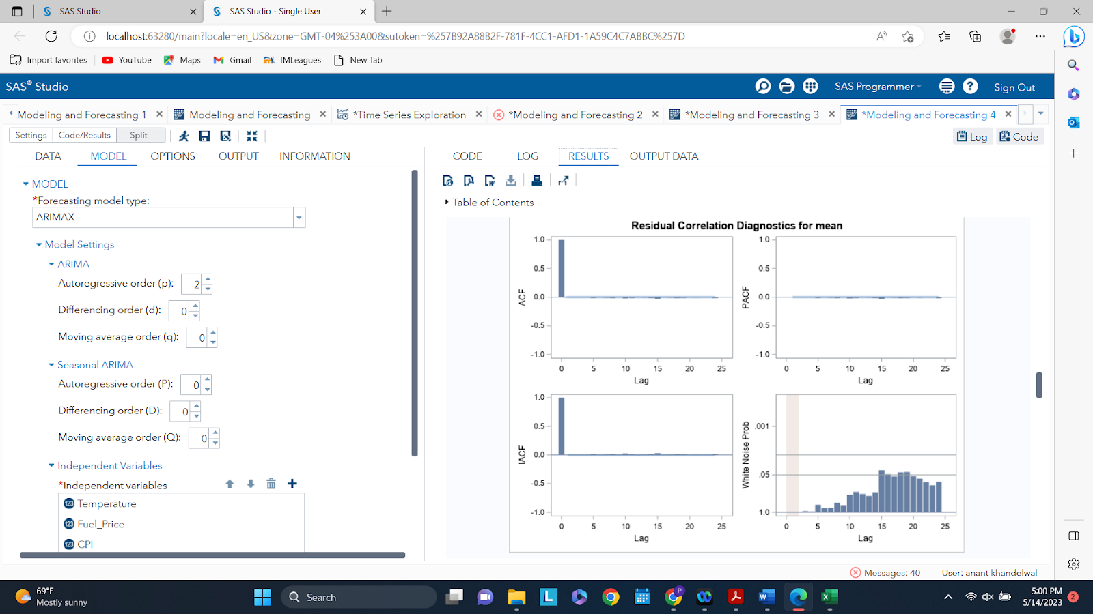
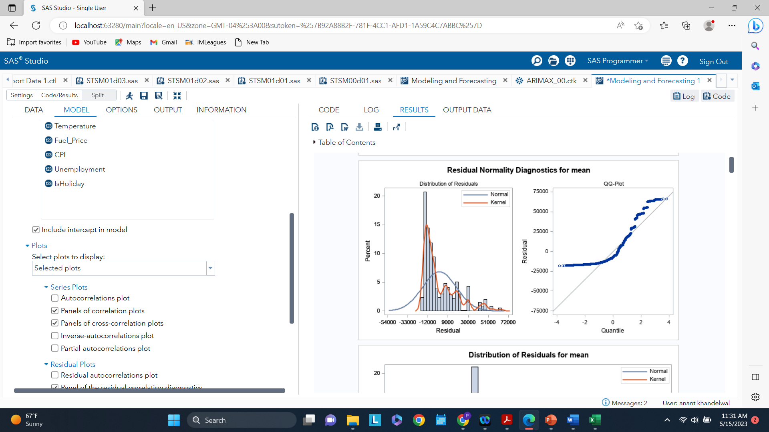
ARIMAX p = 2; q = 0
Checking residuals and white noise
Appears right skewed
NO significant autocorrelation exists
Slight white noise
Notes:
We have used test data for all above performance variables

Slide 13
Optimal model -> ARIMAX(2,0)
Key conclusions
MAPE: 2.22%
AIC: 210334.4
SBC: 210391.5
Forecast:
Shows a drop in sales in the forward time horizon following the trend depicted in fit data

Slide 14
Business Recommendations
Given that the macroeconomic indicators show a positive trend, the forecast shows a decline in sales and hence factors leading to drop should be investigated
01
02
Department level sales trends can be understood to find critical focus areas
Other indicators like quality, delivery of service, price points can be evaluated to understand if there are other factors influencing the sales
03

Slide 15
Thank You!
Any Questions?

